Slide 1


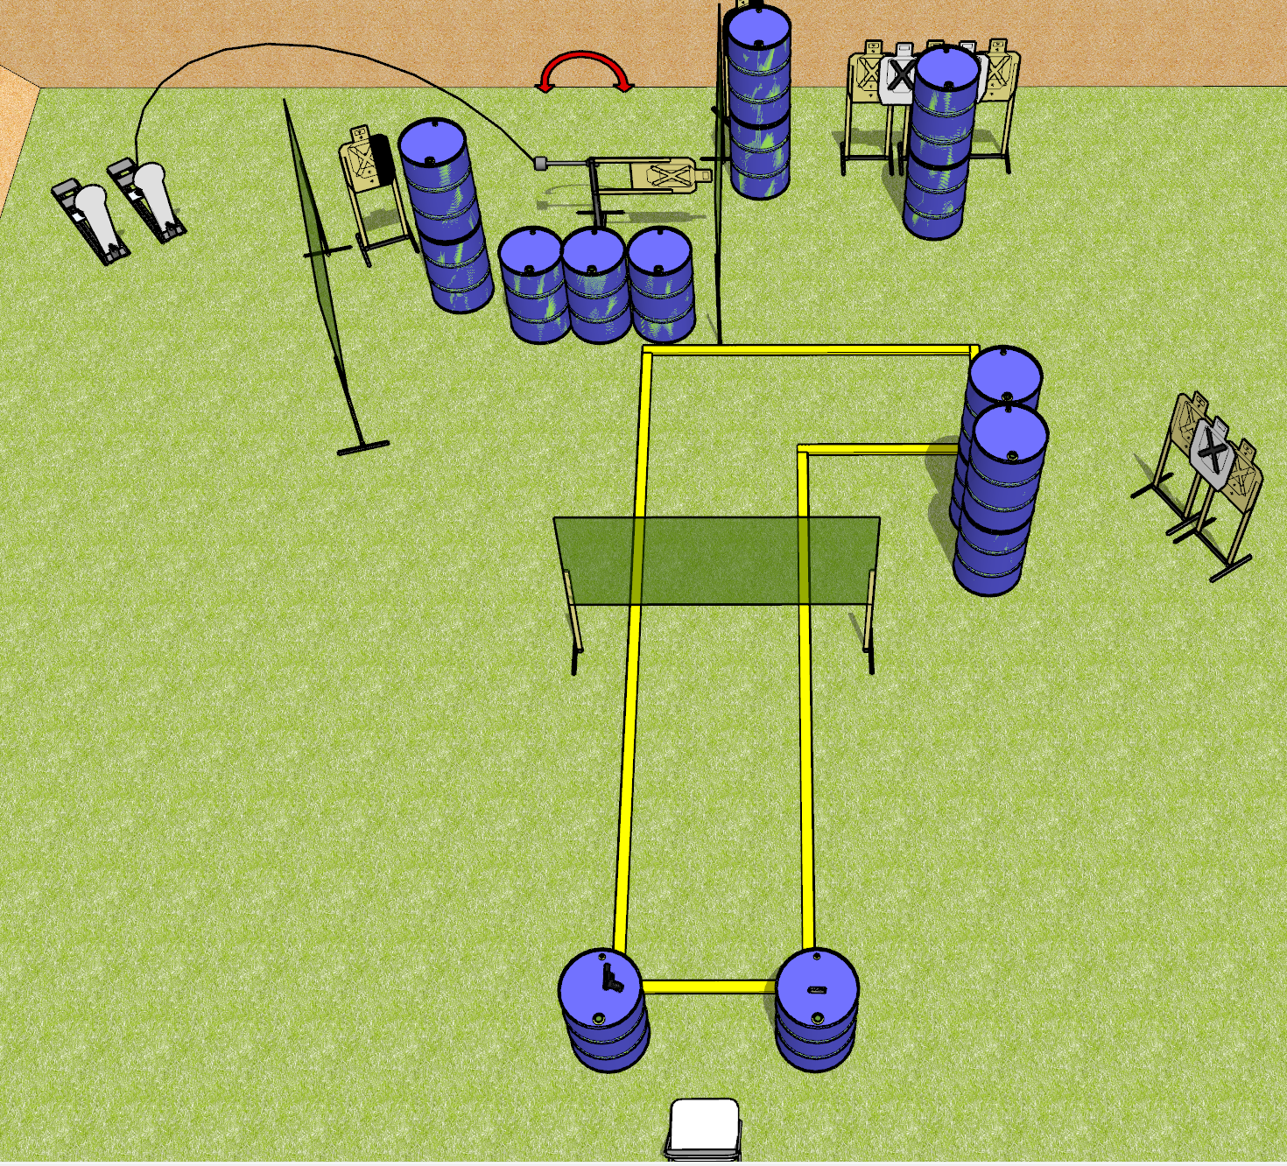
 | Dothan Gun Club – USPSA Match <wookie noises> Course Designer : Drew Coleman
START POSITION : Seated in chair, back flat against seat back, palms on respective knees.
GUN READY CONDITION : Firearm unloaded on either barrel (hammer down). First magazine on opposite barrel. |  | SCORING: Comstock, 18 rounds TARGETS: 8 paper, 2 Steel SCORED HITS: Best 2 on paper, steel until down START-STOP: Audible, last shot RULES: First magazine used must come from barrel, subsequent magazines may come from the belt. When reading stage brief, you must sound like Chewbacca.
STAGE PROCEDURE: Engage targets as they become available from within the fault lines

